Slide 1


Pricing Landscape of Smart Home Gyms
Vishnu Anand | Prashast Vaish | Soutik Banerjee |
Aryan Saxena | Rohan Ajay | Krupasankari Ragunathan

Slide 2
Smart Home Gyms: The Future of Fitness
Consumers now seek convenient, tech-enabled solutions for personalized workouts without the need for a gym membership.
The global smart fitness equipment market is expected to grow significantly, driven by advancements in AI, data analytics, and digital coaching.
The fitness industry has seen a major shift towards connected, AI-driven home gyms, especially post-pandemic.
Notes:
AI Fitness Market: https://www.futuredatastats.com/artificial-intelligence-in-fitness-and-wellness-market?srsltid=AfmBOoo5gGY8UM61WM57-h8Pe_w04NSzKXZ_RPjYVihvbFtc-vSWQ6lv
Home fitness market : https://www.fortunebusinessinsights.com/home-fitness-equipment-market-105118

Slide 3
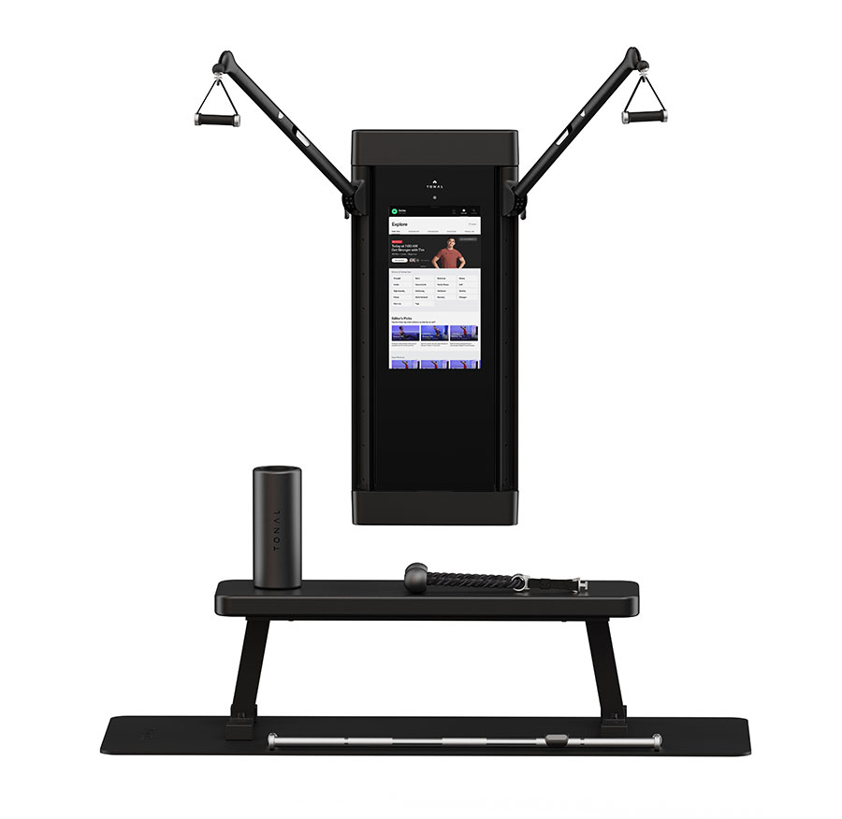
Tonal 2: The AI-Powered Strength Trainer
Wall-mounted smart gym with AI-adjusted resistance (up to 200 lbs).
Uses electromagnetic resistance for smooth, precise weight control.
Built-in sensors track form and progress in real-time.
Features live and on-demand coaching with personalized programs.
Compact design suitable for small spaces.

Slide 4
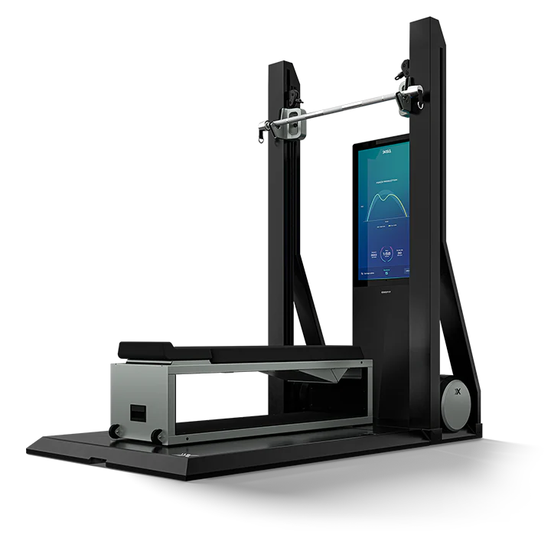
OxeFit: Strength & Cardio Combined
Full-body smart gym integrating strength, cardio, and rehab workouts.
Uses motorized resistance technology with a range up to 250 lbs.
AI-powered performance tracking and biometrics analysis.
Supports rowing, skiing, weightlifting, and resistance training in one device.
Designed for both casual users and professional athletes.

Slide 5
Contrasts in Pricing
As compared to traditional gyms, smart gyms have a simplified approach
Minimal cost to maintain equipment
Tonal 2 provides flexibility as compared to OxeFit
Initial Cost
Notes:
• Equipment Maintenance and Repairs: $350–$800
• Cleaning Supplies: $20–$50
• Utilities: $100–$300
• Insurance: $50–$150
• Miscellaneous Expenses: $50–$100
Treadmil 2750
Power rack 1500
barbell 300
dumbbells 70 (2 per pound)
weight plates 70 (2 per pound)
functinal tools 90 ( 30 each )

Slide 6




Competitor Landscape
Key Features | AI-powered Resistance <= 200 lbs Form Tracking Live Coaching Compact Wall-Mounted Design | Motorized Resistance <= 250 lbs Strength & Cardio Biometrics Tracking Freestanding, larger footprint | Connected Spin Bike Subscription Based Classes Interactive Leaderboard | AI-based guided weightlifting Real-time feedback Adjustable weight set
Target Audience | Affluent Professionals Homeowners with Limited Space | Athletes Strength & Endurance Trainers | Cardio-Focused Users Cycling enthusiasts Group Class Lovers | Weight Training Enthusiasts Users Wanting Guided Workouts
Notes:
AI Fitness Market: https://www.futuredatastats.com/artificial-intelligence-in-fitness-and-wellness-market?srsltid=AfmBOoo5gGY8UM61WM57-h8Pe_w04NSzKXZ_RPjYVihvbFtc-vSWQ6lv
Home fitness market : https://www.fortunebusinessinsights.com/home-fitness-equipment-market-105118

Slide 7
Challenges in Sales
Price Sensitivity: High upfront cost
Dependence on Subscriptions
Competition from Traditional Gyms
AI-driven workouts require trust.

Slide 8




SWOT Analysis for Tonal
Strengths
Weaknesses
Mandatory membership with annual commitment
Initial investment is high (~ $ 4k)
Focuses exclusively on weight training, no cardio options
AI guided training with "Smart View" feedback
Automatic weight adjustment mechanism
Strong brand association (ads by sports and fitness influencers)
Opportunities
Threats
Expanding home fitness market in post-COVID era
Partnerships with other fitness brands (e.g. Optimum Nutrition, Apple Fitness +)
Product line expansion – Tonal Mid!
Competitors like Tempo have lower prices
Technology dependence – software could get bugs, hardware issues can’t be easily fixed
Preference to use traditional gyms

Slide 9
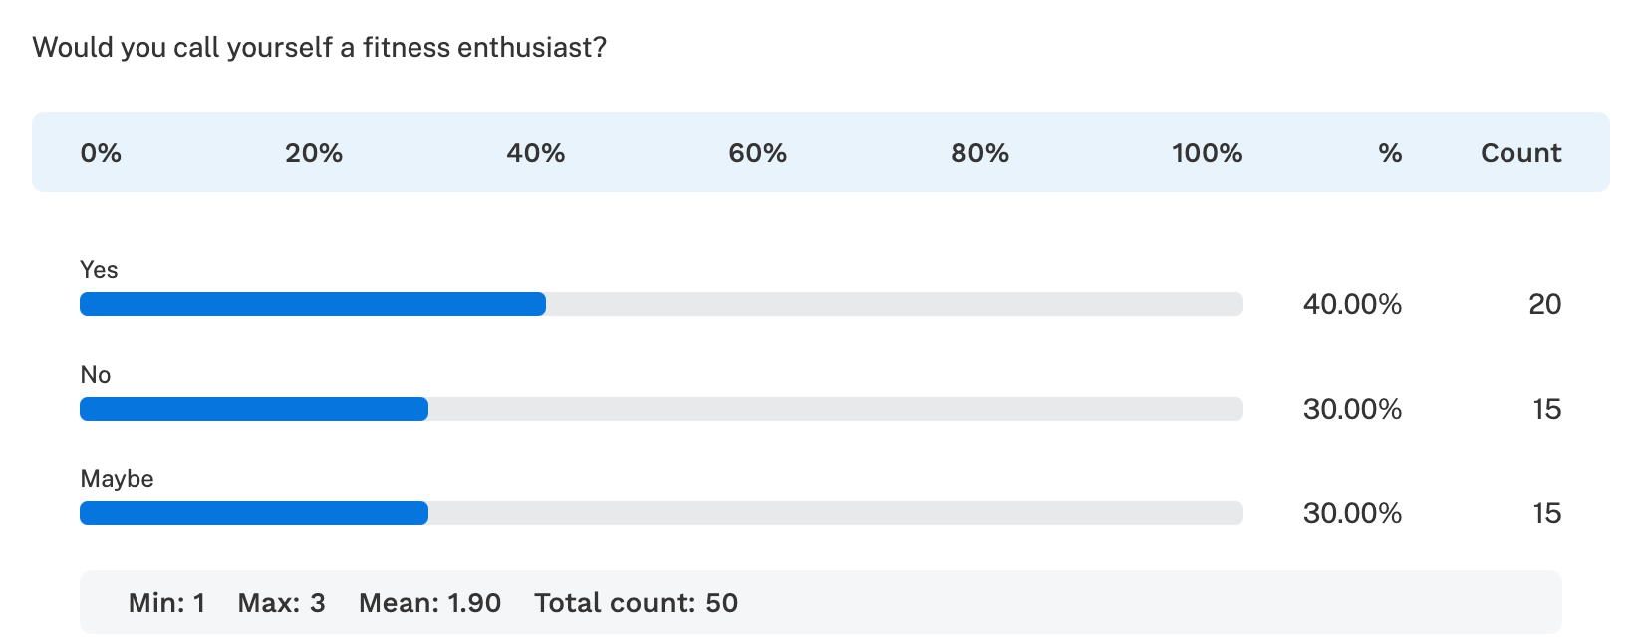
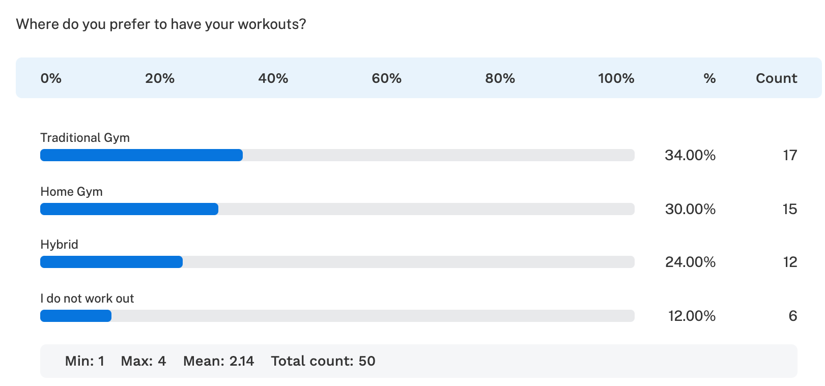
User Survey – Workout Preferences
Would you call yourself a fitness enthusiast?
Where do you prefer to work out?

Slide 10
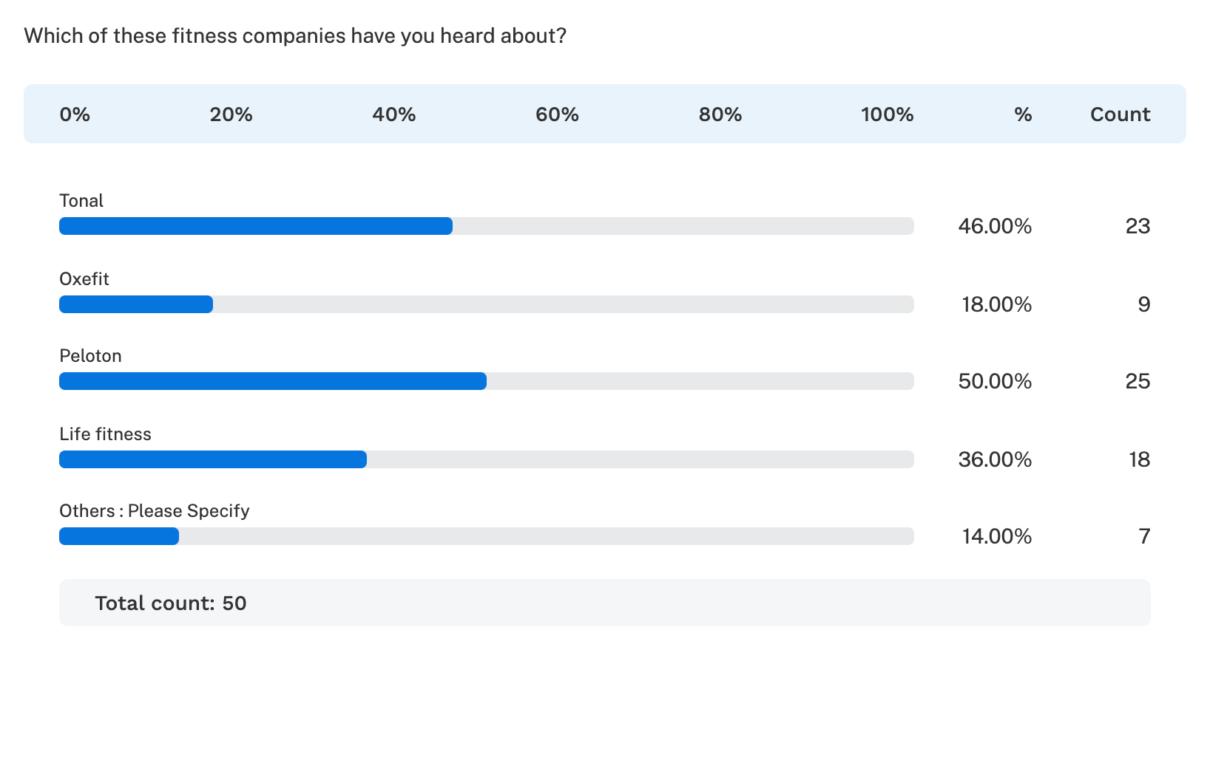
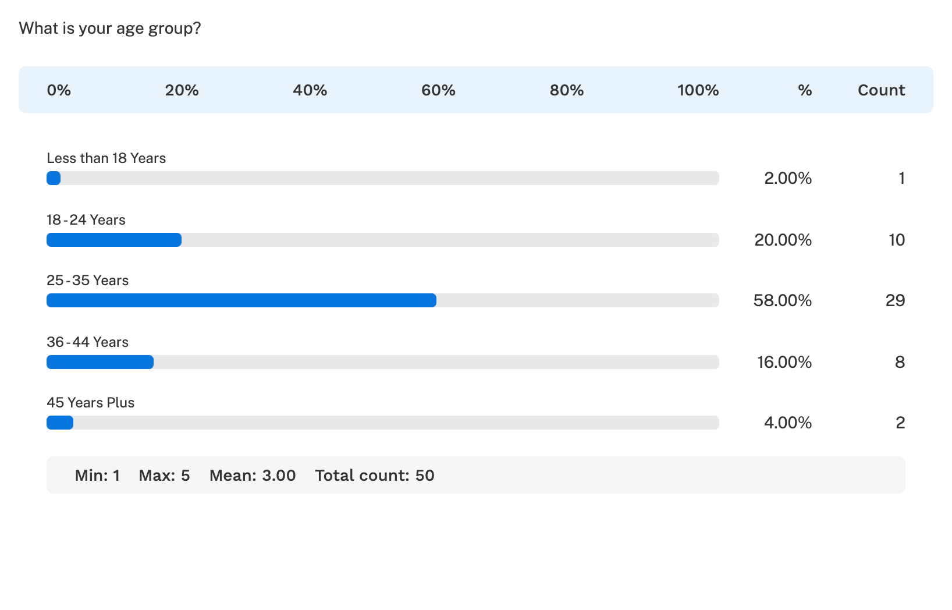
User Survey – Customer Segmentation
Which of these fitness companies have you heard about?
What is your age group?

Slide 11
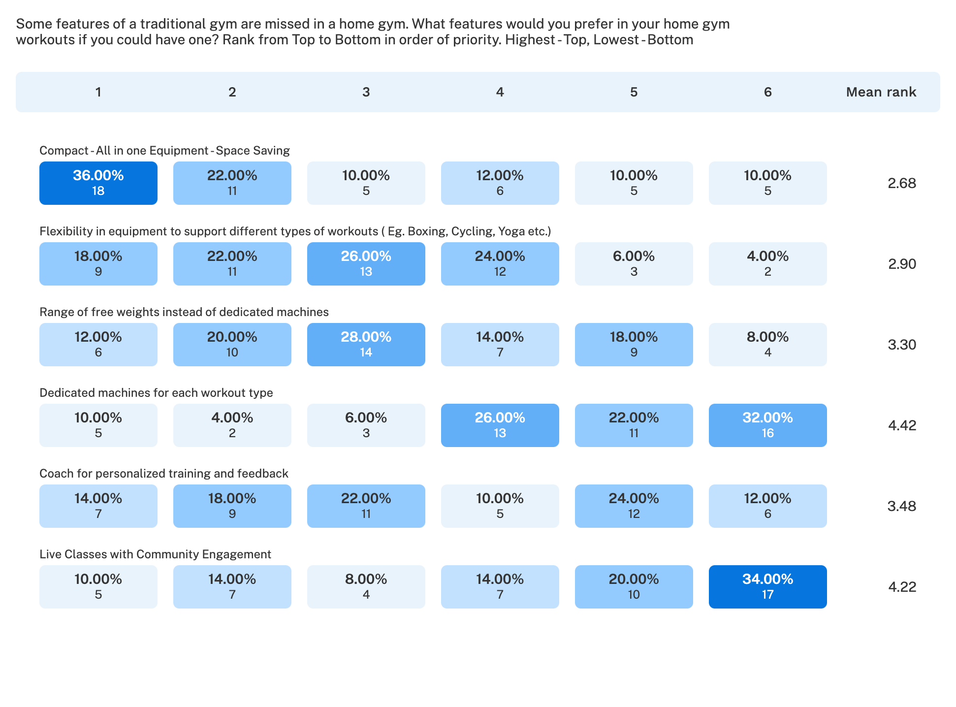
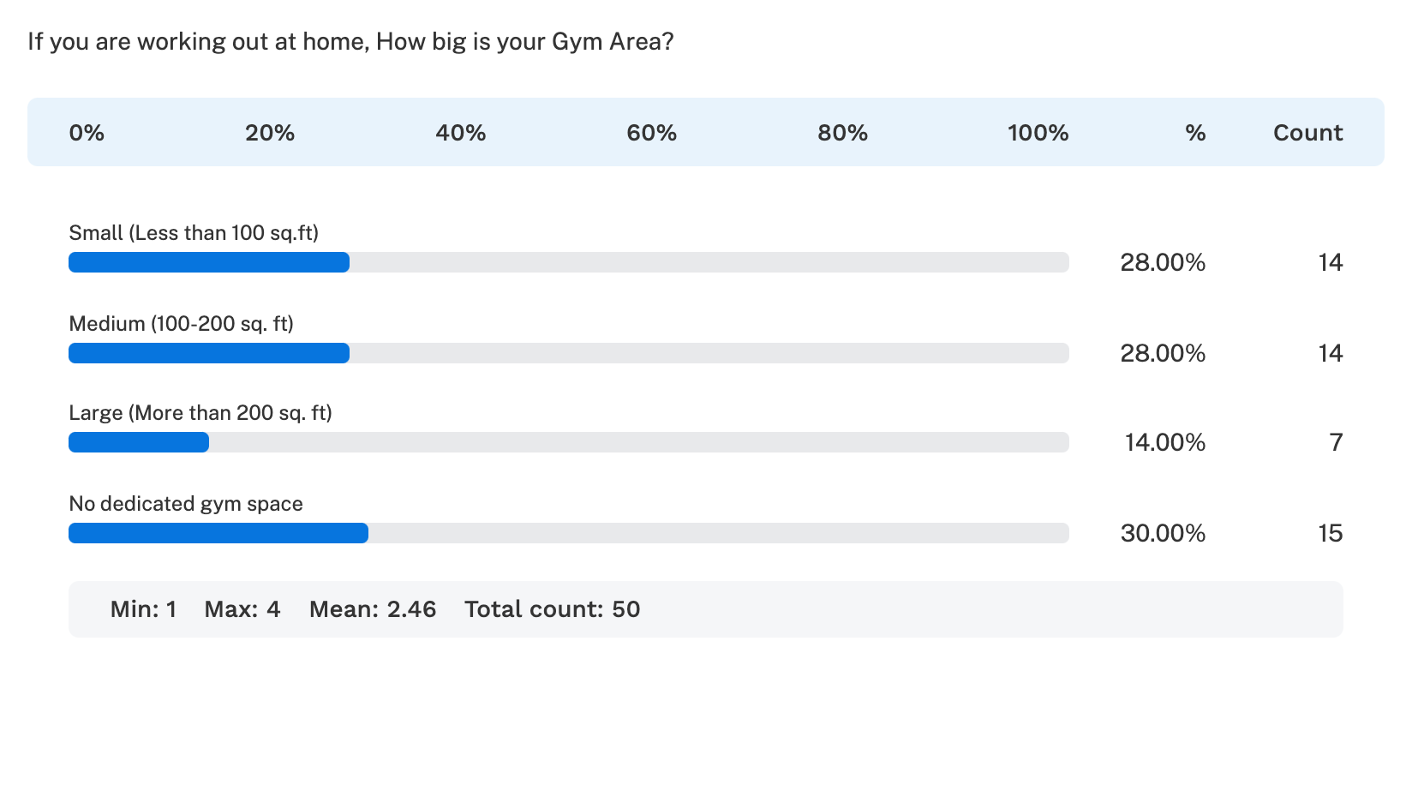
User Survey – Gym preferences
What features of a traditional gym would you prefer in your home gym, if you could have one? Rank from top (highest priority) to bottom.
If you are working out at home, how big is your gym area?

Slide 12
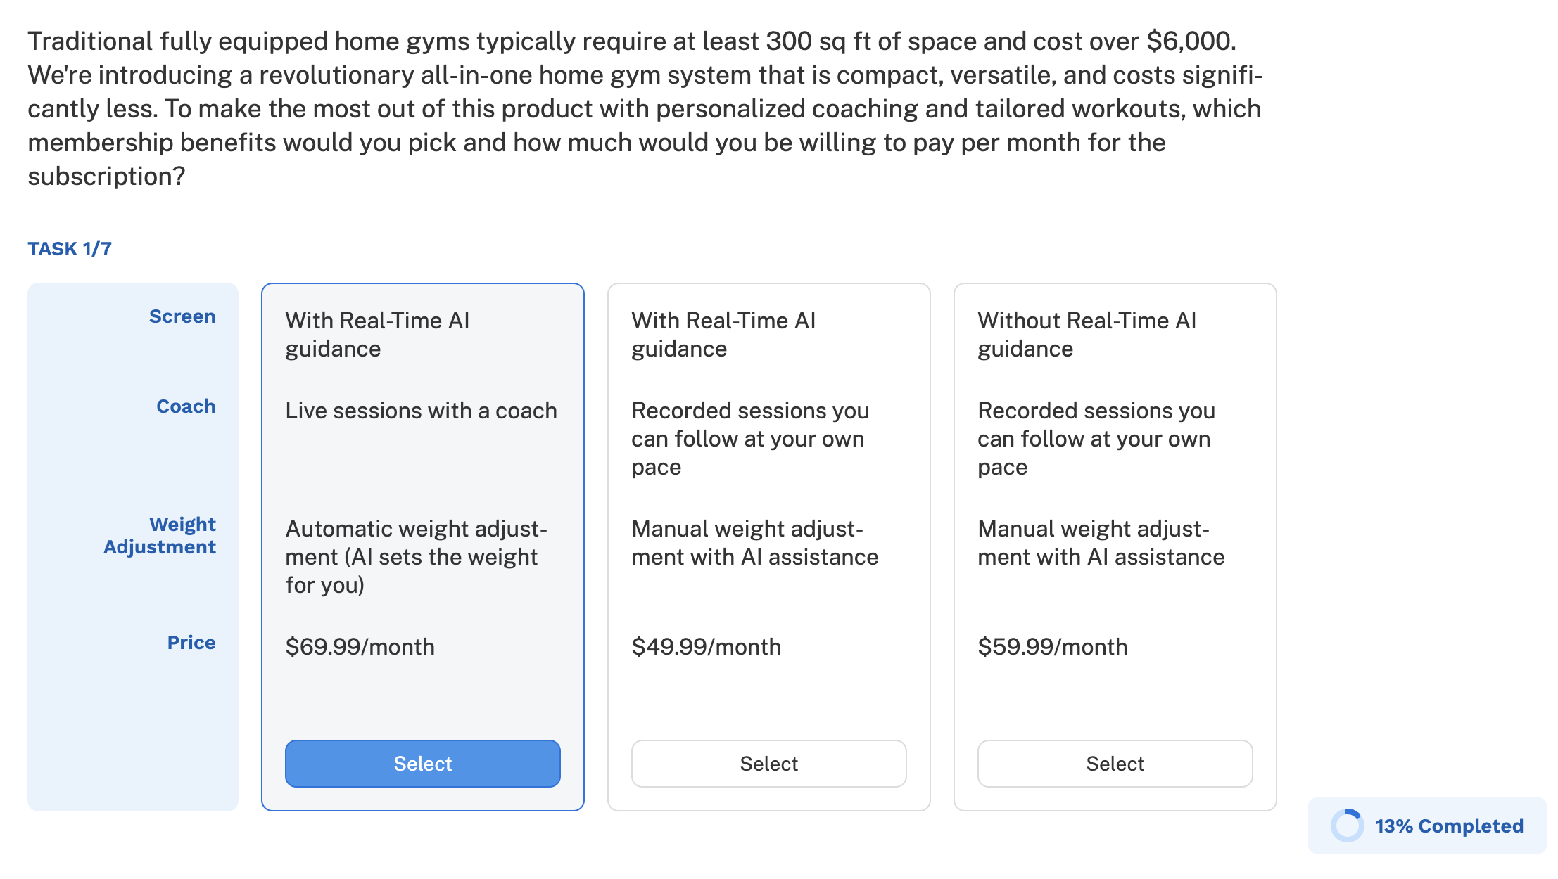
Choice Based Question for Conjoint Analysis

Slide 13
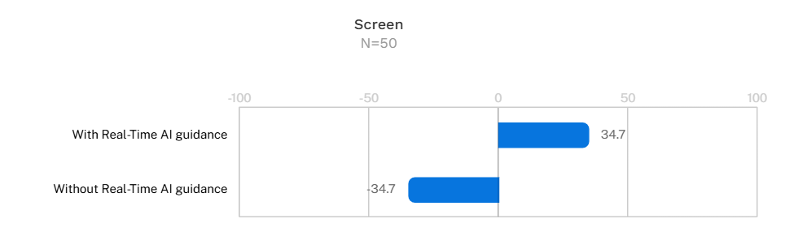
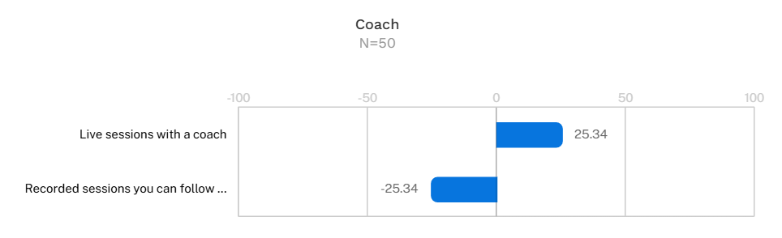
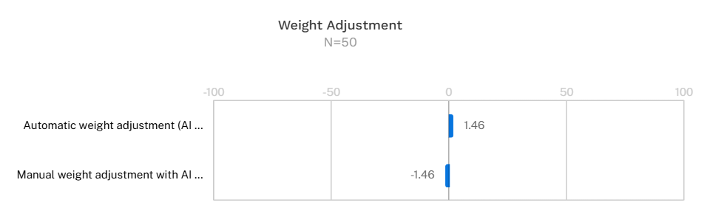
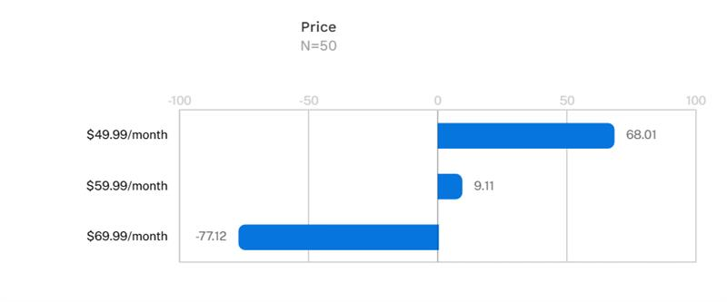
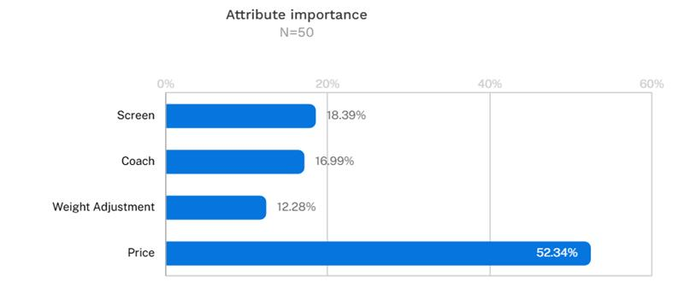
Conjoint Analysis
Relative importance of attributes - customers are most sensitive to price

Slide 14
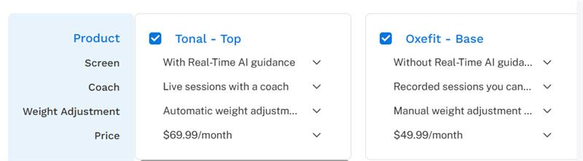
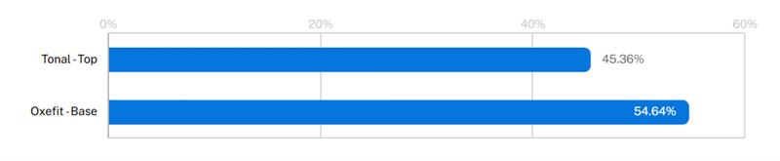
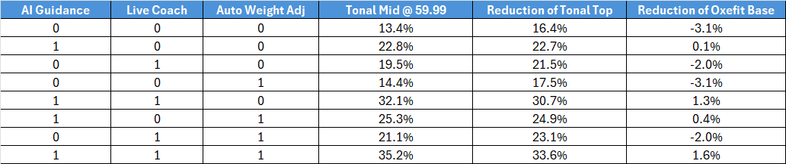
Can Tonal Introduce Tiered Pricing?
The table shows the predicted market share of Tonal Mid if launched @ $59.99 and the resultant changes in market share of Tonal top and Oxefit base.

Slide 15
Inferences & Recommendations
Anchoring effect of OxeFit’s $49.99 is too strong for Tonal to beat with a $59.99 product even if it has additional attributes
Tonal should consider launching a product at the same price point ($49.99) – it will also act as a decoy to push sales of the more premium Tonal products
Tonal needs to focus on the last P among the 4 P’s of marketing – promotion. Strategic collaborations with fitness influencers and sports-personalities will be key in convincing the customer base to associate with Tonal instead of competitors
Leveraging the locked-in customers is key – Tonal should consider launching a loyalty program to ensure these customers do not shift to competitors. Otherwise, there is a huge risk of losing market share.

Slide 16

Questions

Slide 17

References
https://research.contrary.com/company/tonal
https://www.tonal.com/?srsltid=AfmBOoqckgMvqG2J7tQ194znTBpBlMON7GHQnT9r65qe0cuGDvDzGobv
https://www.oxefit.com/
https://www.prnewswire.com/news-releases/home-fitness-equipment-market-to-grow-by-usd-4-44-billion-2024-2028-increased-demand-for-home-fitness-equipment-boosts-the-market-report-on-ai-powered-market-evolution---technavio-302369519.html

